Slide 1
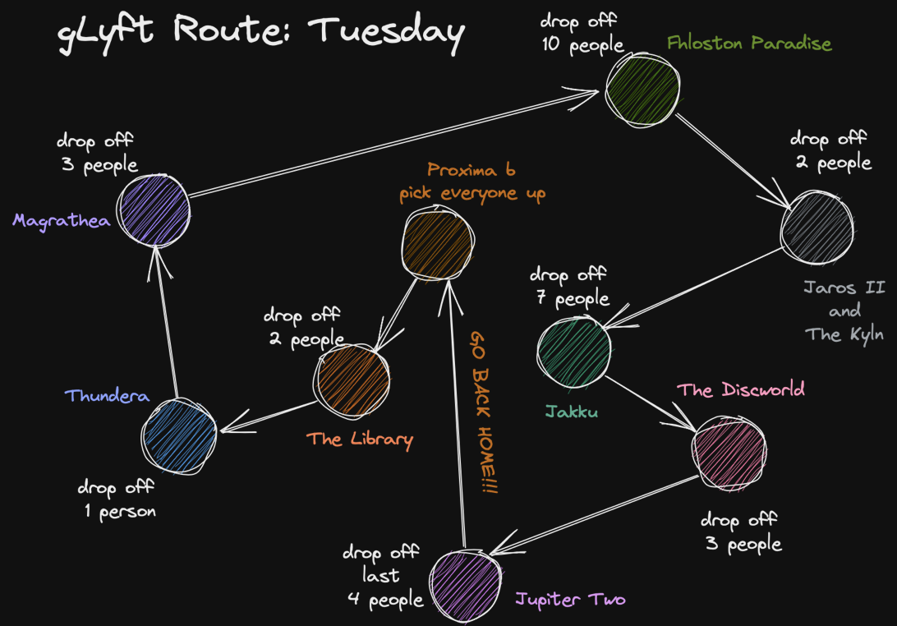
ENGR 101 – C++ Project Overview
Make sure you have these files downloaded from the google drive (Lecture Materials > Lecture 11 – C++ Project Overview). Make sure to save the files in the same folder:
bird_recipes.txt
cat_recipes.txt
reptile_recipes.txt
rodent_recipes.txt
special_dog_diets.txt
KitchenTasklist.cpp
Note: These files are for exercises today demonstrating some things related to the C++ Project. You don’t need them to actually do the project.
These slides (minus the solutions!) are also available on the google drive.
Laura Alford and Lesa Begley
November 10th, 2026

Slide 2
Announcements/Reminders
Quiz 4 is happening
  Be sure to take the quiz at your scheduled time.
Lessons are done! There is no new content left to learn. The rest of the semester is focused on choosing and adapting the correct content to solve various engineering problems.

Slide 3
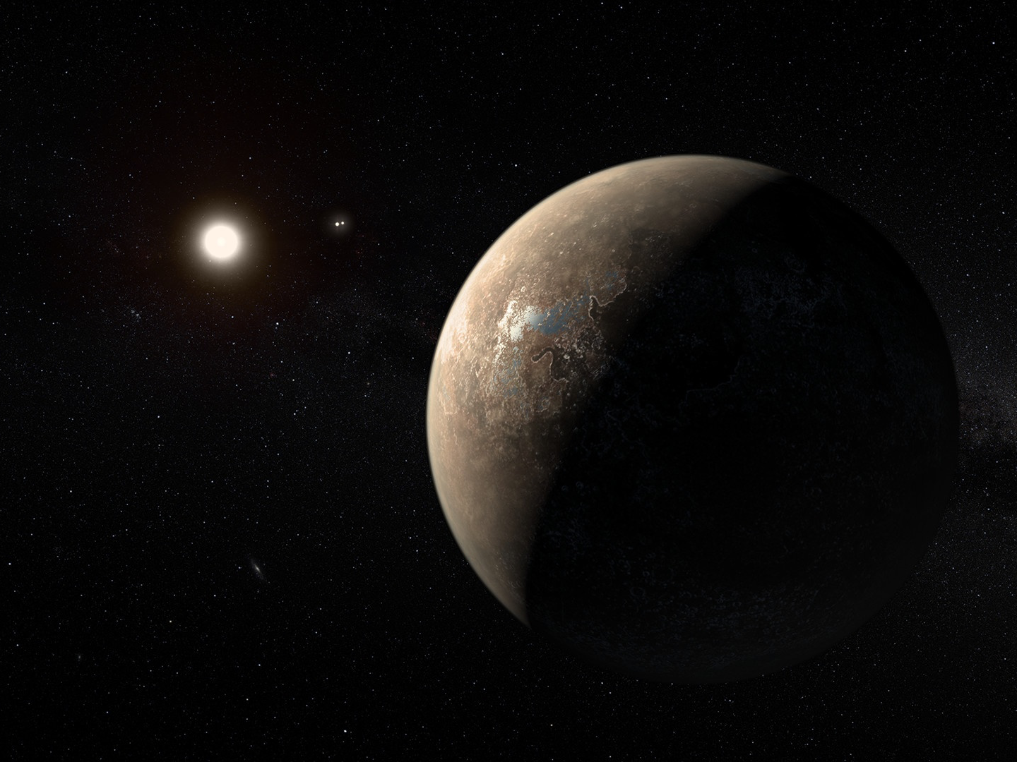
Alpha Centauri (binary star system)
Proxima Centauri (red dwarf star)
Proxima b
Artist’s Rendering:
M. Kornmesser / ESO

Slide 4
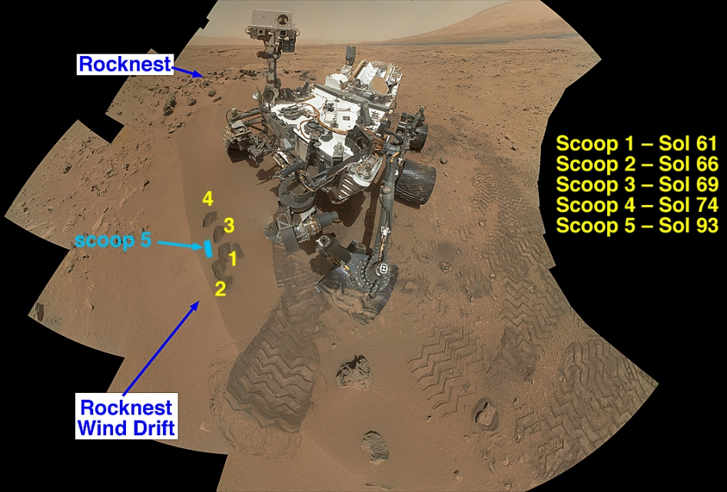
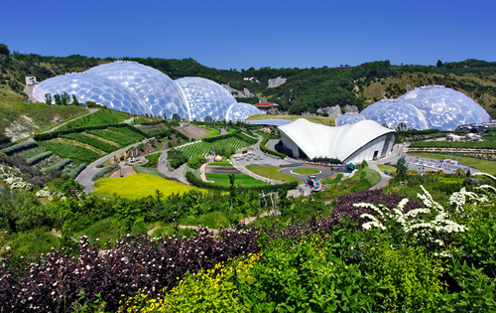
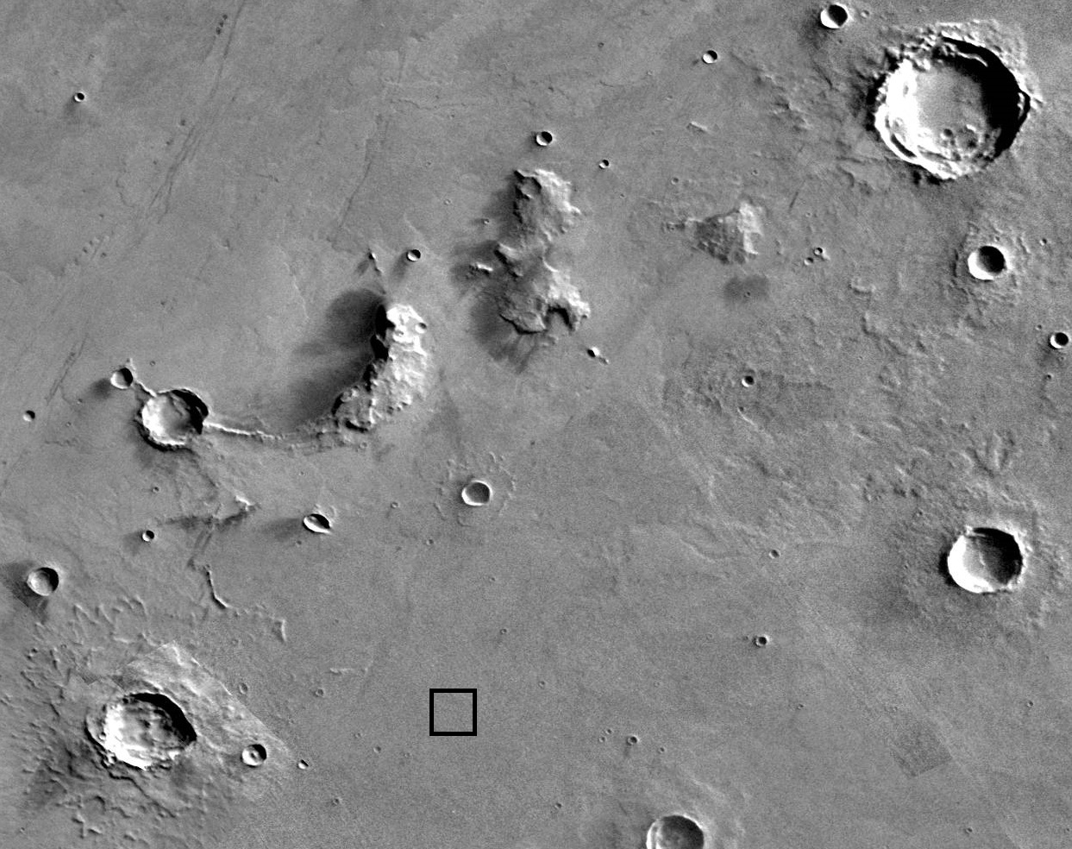
Previously on our show…
soil tested positive for farming (woot!)
and built ourselves a domed shelter with underground storage
NASA's Curiosity Mars rover documenting soil samples
(NASA/JPL-Caltech/MSSS)
so we located our settlement

Slide 5
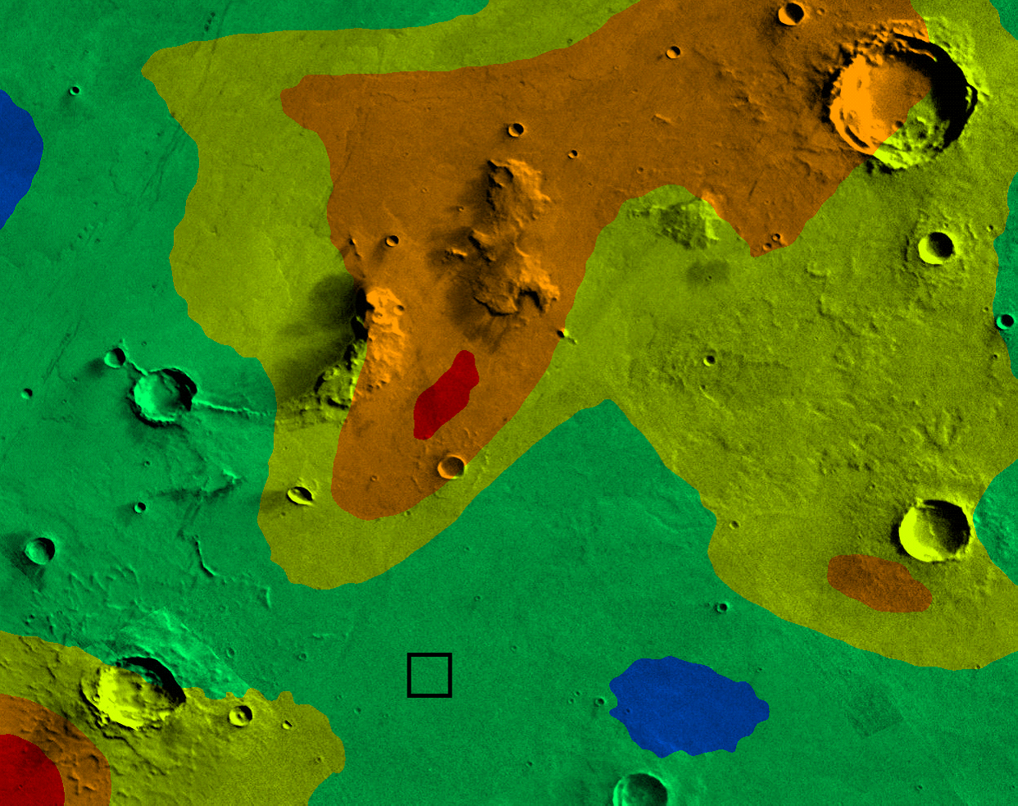
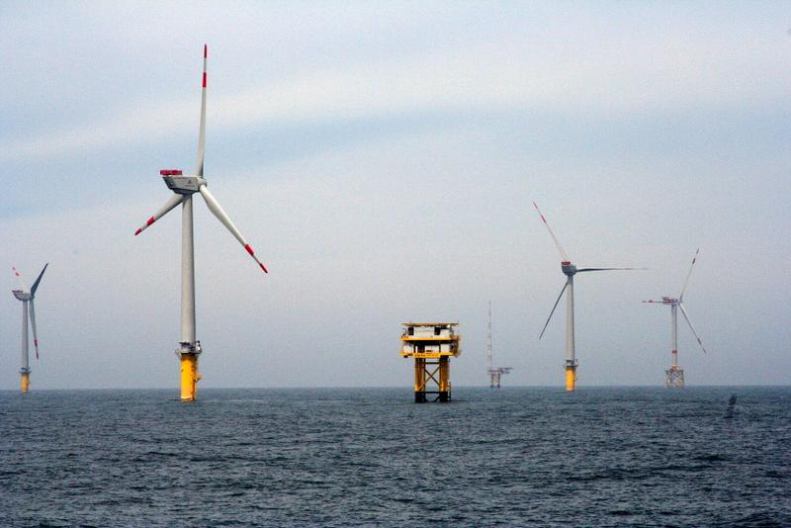
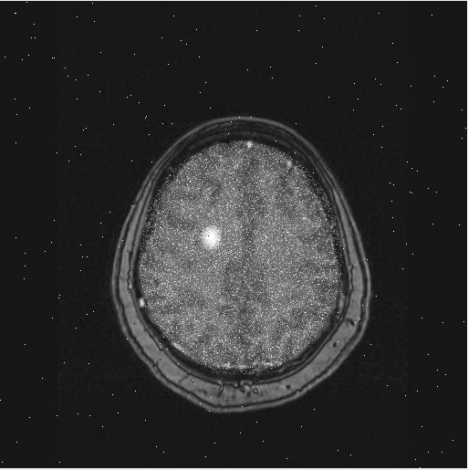
Now people are living here…
predicting radiation storms
generating renewable power
checking for tumors to help keep people safe

Slide 6
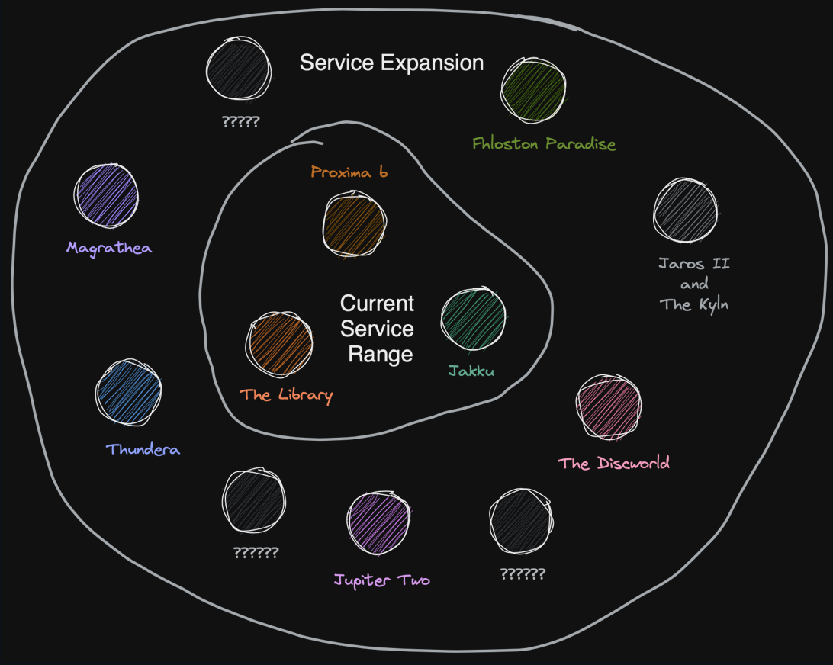
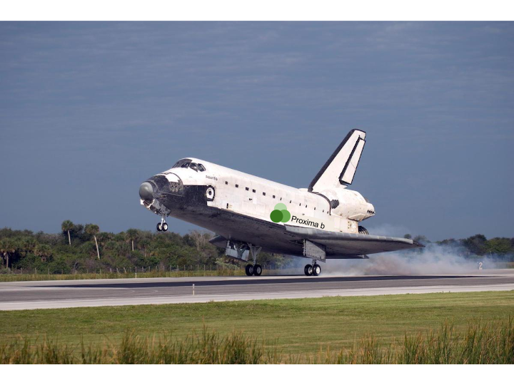
…but they want to travel to other places, too!
We’ve built a spaceport and it is thriving! Proxima b is now the galactic headquarters of the planetary ride-sharing company: gLyft!
gLyft is looking to expand their service range, but this requires a new level of route-planning capability
gLyft

Slide 7
C++ Project: gLyft
Problem:
What’s the shortest route to deliver all passengers?
Program:
(you do this)
Success:
check against test cases
Algorithm:
(you do this)
Idea:
model route as a traveling salesperson problem
Evaluation:
Autograder checks against all test cases

Slide 8
Your Job
Write a program that finds the shortest path from each planet to the next within your gLyft driver’s range.

Slide 9
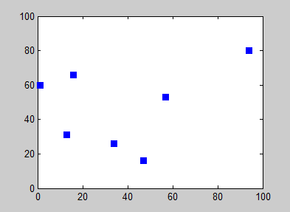
Engineering Concepts: Traveling Salesperson Problem
Nearest Neighbor algorithm:
  Start at a given location
  Find the closest location that has not already been visited
  Go to that location
  Mark that location as “visited”
  Repeat steps 2-4 until all locations have been visited
  Go to the specified end location

Slide 10

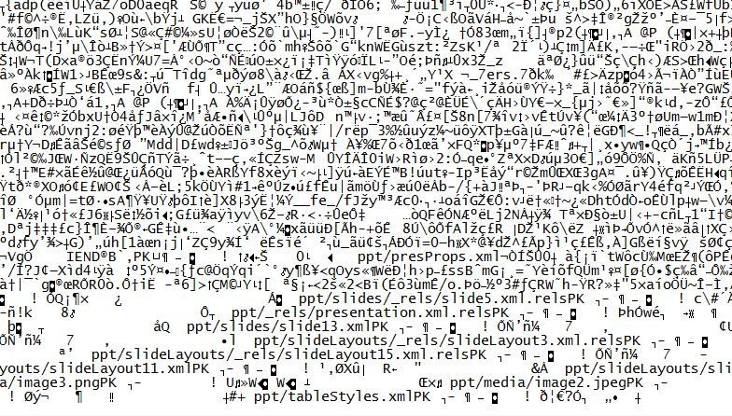
Engineering Concepts: Data Corruption
Data on computers is stored as a crap ton of 0s and 1s.
Sometimes, when you copy data, the 0s get turned into 1s
and the 1s get turned into 0s.
This corrupts data you copied (it’s not the same as the original).

Slide 11
Program Task
take the location data
and the planet names
locations.txt
names.txt
13 5
2 5
5 1
2 2 X 7924
13 1 T 5555
5 2 Q 8753
19 4 Q 8434
8 3 P 2341
7 1 X 2523
1 19 T 6341
2 3 X 5125
-2 2 T 7632
1 0 Q 1111
6 3 A 9349
9349 The_Library
8753 New_Earth_(Planet_Bob)
5555 Fhloston_Paradise
2523 Jupiter_Two
7924 Domeo_And_James_Juliett
5125 Etheria_and_Eternia
6341 Planet_X
1111 Jaros_II_and_The_Kyln
8434 Polyphemus_and_Pandora
2341 The_Discworld
7632 Planet_Drool
the planet IDs link the information in the two files

Slide 12
Program Task
journey.txt
and determine the route for the gLyft driver
.....
.XX.S
.....
.....
EQ...
..A..
X....
..P..
.....
.....
.....
.....
T....
Start at 2 5
Go to Etheria and Eternia at 2 3
Go to Domeo And James Juliett at 2 2
Go to New Earth (Planet Bob) at 5 2
Go to The Library at 6 3
Go to The Discworld at 8 3
Go to Jupiter Two at 7 1
Go to Fhloston Paradise at 13 1
End at 5 1
a grid that represents a “map” of the starting point, the planets to be visited, and the ending point
The order of the locations (planets) to be visited
A blank line to keep the Autograder happy

Slide 13
How Should We Represent The Planet Data in Our Program?
locations.txt
names.txt
13 5
2 5
5 1
2 2 X 7924
13 1 T 5555
5 2 Q 8753
19 4 Q 8434
8 3 P 2341
7 1 X 2523
1 19 T 6341
2 3 X 5125
-2 2 T 7632
1 0 Q 1111
6 3 A 9349
9349 The_Library
8753 New_Earth_(Planet_Bob)
5555 Fhloston_Paradise
2523 Jupiter_Two
7924 Domeo_And_James_Juliett
5125 Etheria_and_Eternia
6341 Planet_X
1111 Jaros_II_and_The_Kyln
8434 Polyphemus_and_Pandora
2341 The_Discworld
7632 Planet_Drool
Each planet has items of information about it. A vector of structs would be a great way to store this planet data!

Slide 14
PRACTICE: PET FOOD RECIPES

Slide 15
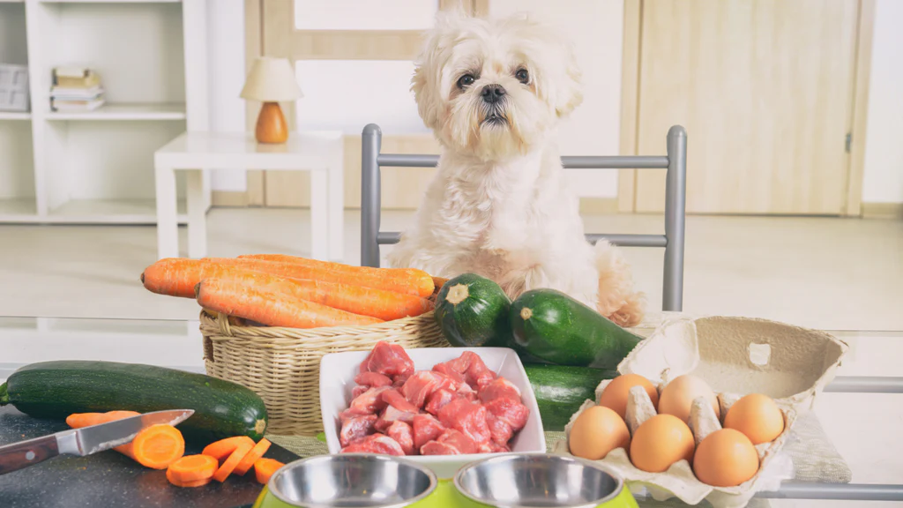
Let’s Practice: Building a Vector of Structs
Proxima b Pet Care (PBPC) has expanded its services and is now creating pet food formulations for the unique pets on Proxima b
Let’s use our programming skills to create a Recipe Book for PBPC!
PBPC Pet Food – It’s Out Of This World!

Slide 16
Making the PBPC Pet Food Recipe Book
Code along with me as we get the recipe book going with some recipes to feed hungry pet dogs.
Each recipe has 4 pieces of information: the name, how many minutes it takes to prepare, the number of servings it generates, and whether it includes meat as an ingredient.
Our first step will be to create a Recipe struct to hold this information!

Slide 17
The Recipe Struct
Open up VS code and start a new C++ program called DogFoodRecipes.cpp.
struct Recipe{
string name;
int prepTime;
double servings;
bool hasMeat;
};

Slide 18

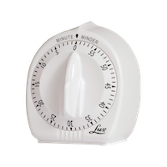
Exercise: Add a Puppy Chow Recipe
2 min
Create a recipe that holds the information for "Puppy_Chow" in a Recipe struct
Add the recipe to the DogFood vector using push_back()
Done!
Puppy_Chow
prep time = 15 minutes
makes 10 servings
contains meat
int main(){
Recipe MediumDogFood = {"Medium_Adult_Dog_Food",30,10,1};
Recipe SmallDogFood = {"Small_Adult_Dog_Food",50,20,1};
Recipe VegDogFood = {"Vegetarian_Dog_Food",40,6,0};
vector <Recipe> DogFood {MediumDogFood, SmallDogFood, VegDogFood};
cout << DogFood.at(1).name <<" feeds this many animals: " << DogFood.at(1).servings << endl;
Recipe LargeDogFood = {"Large_Adult_Dog_Food",25,12,1};
DogFood.push_back(LargeDogFood);
cout <<DogFood.at(3).name<<" takes this many minutes to prepare: " <<DogFood.at(3).prepTime<<endl;
}
Create puppy chow Recipe here
Add puppy chow Recipe here

Slide 19
Solution: Add a Puppy Chow Recipe
int main(){
Recipe MediumDogFood = {"Medium_Adult_Dog_Food",30,10,1};
Recipe SmallDogFood = {"Small_Adult_Dog_Food",50,20,1};
Recipe VegDogFood = {"Vegetarian_Dog_Food",40,6,0};
vector <Recipe> DogFood {MediumDogFood, SmallDogFood, VegDogFood};
cout << DogFood.at(1).name <<" feeds this many animals: "
<< DogFood.at(1).servings << endl;
Recipe LargeDogFood = {"Large_Adult_Dog_Food",25,12,1};
DogFood.push_back(LargeDogFood);
cout <<DogFood.at(3).name<<" takes this many minutes to prepare: "
<<DogFood.at(3).prepTime<<endl;
Recipe PuppyChow = {"Puppy_Chow",15,10,1};
DogFood.push_back(PuppyChow);
}

Slide 20
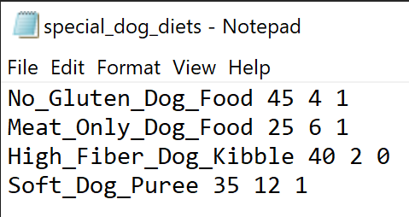
Add Special Diet Recipes From the Web
Your recipe book is coming along well and you want to add in recipes for dogs with special dietary needs.
You have these recipes in a text file already, having pulled them from DogDiets.com.

Slide 21
Write a function to help us load in these Recipe structs
We wrote a helper function to load in structs in the Rover Mission! We’ve already done the hard part. We can use this as a starting point to complete this part of our current program.
Open up your rovers.cpp file and copy the loadRovers definition over to DogFoodRecipes.cpp.
Let’s go modify this function to fit our needs for adding recipes to our cookbook.

Slide 22
loadRecipes helper function
#include <string>
#include <vector>
#include <iostream>
#include <fstream>
using namespace std;
struct Recipe{
string name;
int prepTime;
double servings;
bool hasMeat;
};
void loadRovers (vector <Rover> &fleet, istream &input) {
Rover rover;
rover.isSelected = false;
while (input >> rover.type >> rover.id >> rover.capacity >> rover.chargeNeeded){
fleet.push_back(rover);
}
}
Function as copied from rovers.cpp file

Slide 23
loadRecipes helper function Solution
//Includes and namespace
//Struct definition
void loadRecipes (vector <Recipe> &meals, ifstream &input) {
Recipe recipeToAdd;
while (input >> recipeToAdd.name >> recipeToAdd.prepTime >> recipeToAdd.servings >> recipeToAdd.hasMeat){
meals.push_back(recipeToAdd);
cout <<"Adding "<< recipeToAdd.name <<endl;
}
cout <<"All done! "<<endl;
};

Slide 24
Load in special diet recipes using our new function
//Program continued from int main()
vector <Recipe> SpecialDogFood; //Declare a vector to hold the special recipes
ifstream SpecialRecipes ("special_dog_diets.txt"); //Create a filestream for the data to be read in
loadRecipes(SpecialDogFood, SpecialRecipes);
cout<<SpecialDogFood.at(2).name<< " takes "<<SpecialDogFood.at(2).prepTime<<" minutes to cook." <<endl; //Display the name and cooktime of the third special recipe

Slide 25
Next Step: Make a Task List for the Kitchen
The food prep manager at PBPC needs to create a task list for the staff each day, assigning which recipes need to be prepared based on pet owner orders
The task list should be displayed as a grid of Xs. The kitchen manager will later enter in information about number of batches of each recipe that need to be prepared, which will change from day to day!
The grid is a graphical representation of the recipes in the recipe book; each row is a chapter, containing recipes for one type of pet, and each column is an individual recipe.

Slide 26
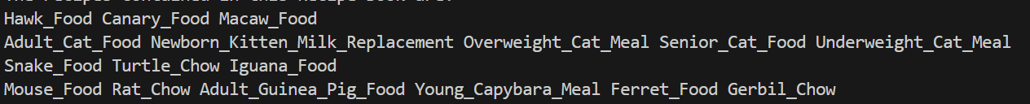
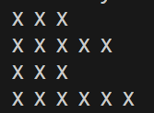
Take this…
and represent it like this

Slide 27
Algorithm for KitchenTasklist
Create the Cookbook
1. Use a struct and helper function from DogFoodRecipes.cpp to create the chapters for the recipe book.
2. Assemble the chapters to form the recipe book.
3. Iterate through the recipe book and print out the names of the recipes.
4. Create a grid representation of the recipe book as requested by the manager by printing an X for each recipe in the chapter.
Create the Tasklist

Slide 28
Let’s Code – KitchenTasklist.cpp
KitchenTasklist.cpp has the program all set up in pseudocode.
Some steps are complete and have the pseudocode commented out
Let’s go complete the first part of the program to create the cookbook.

Slide 29
Accessing Recipes in the RecipeBook Vector of Vectors
Recipe
Recipe
Recipe
This is what is in the RecipeBook variable.
Dog_Food_1
35
14
1
Dog_Food_2
30
5
1
Dog_Food_3
60
10
0
0
1
2
Recipe
Recipe
Cat_Food_1
25
20
1
Cat_Food_2
40
10
0
0
1

Slide 30
Accessing Recipes in the RecipeBook Vector of Vectors
Recipe
Recipe
Recipe
Dog_Food_1
35
14
1
Dog_Food_2
30
5
1
Dog_Food_3
60
10
0
RecipeBook.at(0)
outer loop is the “chapter” of the recipe book
(index variable i)
0
1
2
Recipe
Recipe
Cat_Food_1
25
20
1
Cat_Food_2
40
10
0
RecipeBook.at(1)
0
1

Slide 31
Accessing Recipes in the RecipeBook Vector of Vectors
Recipe
Recipe
Recipe
Dog_Food_1
35
14
1
Dog_Food_2
30
5
1
Dog_Food_3
60
10
0
RecipeBook.at(0)
0
1
2
RecipeBook.at(0).at(0)
RecipeBook.at(0).at(1)
inner loop is the recipe
(index variable j)
RecipeBook.at(0).at(2)

Slide 32
Accessing Recipes in the RecipeBook Vector of Vectors
Recipe
Recipe
Recipe
Dog_Food_1
35
14
1
Dog_Food_2
30
5
1
Dog_Food_3
60
10
0
RecipeBook.at(0)
0
1
2
RecipeBook.at(0).at(1)
.name
member variable name

Slide 33
Print the Recipe Names as a Grid: Choose the Correct Indexing Steps
cout<<"The recipes contained in this Recipe Book are: "<<endl;
for (int i = 0; i<RecipeBook.size(); ++i){
for (int j = 0; j<RecipeBook.at(i).size(); ++j){
cout << RecipeBook.at(i).name << " ";
}
cout << endl;
A
cout<<"The recipes contained in this Recipe Book are: "<<endl;
for (int i = 0; i<RecipeBook.size(); ++i){
for (int j = 0; j<RecipeBook.at(i).size(); ++j){
cout << RecipeBook.at(j).name << " ";
}
cout << endl;
B
cout<<"The recipes contained in this Recipe Book are: "<<endl;
for (int i = 0; i<RecipeBook.size(); ++i){
for (int j = 0; j<RecipeBook.at(i).size(); ++j){
cout << RecipeBook.at(i).at(j).name << " ";
}
C
cout<<"The recipes contained in this Recipe Book are: "<<endl;
for (int i = 0; i<RecipeBook.size(); ++i){
for (int j = 0; j<RecipeBook.at(i).size(); ++j){
cout << RecipeBook.name.at(j) << " ";
}
D

Slide 34
Print the Recipe Names as a Grid: Choose the Correct Indexing Steps
cout<<"The recipes contained in this Recipe Book are: "<<endl;
for (int i = 0; i<RecipeBook.size(); ++i){
for (int j = 0; j<RecipeBook.at(i).size(); ++j){
cout << RecipeBook.at(i).at(j).name << " ";
}
C

Slide 35
Print the Recipe Names as a Grid: Choose the Correct Indexing Steps
Choosing The Chapter
Choosing The Recipe
cout<<"The recipes contained in this Recipe Book are: "<<endl;
for (int i = 0; i<RecipeBook.size(); ++i){
for (int j = 0; j<RecipeBook.at(i).size(); ++j){
cout << RecipeBook.at(i).at(j).name << " ";
}
C
Choosing The Name

Slide 36
KitchenTasklist.cpp
#include <string>
#include <vector>
#include <iostream>
#include <fstream>
using namespace std;
struct Recipe{
string name;
int prepTime;
double servings;
bool hasMeat;
};
void loadRecipes (vector <Recipe> &chapter, ifstream &input) {
Recipe recipeToAdd;
while (input >> recipeToAdd.name >> recipeToAdd.prepTime >> recipeToAdd.servings >> recipeToAdd.hasMeat){
chapter.push_back(recipeToAdd);
cout<< "Adding " << recipeToAdd.name<<endl;
}
cout<<"All Done!"<<endl;
}

Slide 37
KitchenTasklist.cpp continued
int main(){
// Read in recipes for 4 different types of pet to create the chapters
vector <Recipe> BirdFood;
ifstream birdIn ("bird_recipes.txt");
loadRecipes(BirdFood, birdIn);
birdIn.close();
vector <Recipe> CatFood;
ifstream catIn ("cat_recipes.txt");
loadRecipes(CatFood, catIn);
catIn.close();
vector <Recipe> ReptileFood;
ifstream reptileIn ("reptile_recipes.txt");
loadRecipes(ReptileFood, reptileIn);
reptileIn.close();
vector <Recipe> RodentFood;
ifstream rodentIn ("rodent_recipes.txt");
loadRecipes(RodentFood, rodentIn);
rodentIn.close();

Slide 38
KitchenTasklist.cpp continued
// Compile the chapters into a Recipe Book by creating a vector of vectors. Recipe Book holds four vectors, each for one pet.
vector <vector <Recipe> > RecipeBook;
RecipeBook.push_back(BirdFood);
RecipeBook.push_back(CatFood);
RecipeBook.push_back(ReptileFood);
RecipeBook.push_back(RodentFood);
// Print out the recipe names.
cout<<"The recipes contained in this Recipe Book are: "<<endl;
for (int i = 0; i<RecipeBook.size(); ++i){
for (int j = 0; j<RecipeBook.at(i).size(); ++j){
cout << RecipeBook.at(i).at(j).name << " ";// add in a choose the right indexing exercise here
}
cout << endl;
}
// Visualize the recipe book as a grid of "X".
cout<<"Here is your tasklist for today. X means you don't need to prepare that recipe; numbers indicate how many batches of that recipe need to be prepped."<<endl;
for (int i = 0; i<RecipeBook.size(); ++i){
for (int j = 0; j<RecipeBook.at(i).size(); ++j){
cout << "X" << " ";
}
cout << endl;
}
}

Slide 39
KitchenTasklist.cpp terminal output
Adding Hawk_Food
Adding Canary_Food
Adding Macaw_Food
All Done!
Adding Adult_Cat_Food
Adding Newborn_Kitten_Milk_Replacement
Adding Overweight_Cat_Meal
Adding Senior_Cat_Food
Adding Underweight_Cat_Meal
All Done!
Adding Snake_Food
Adding Turtle_Chow
Adding Iguana_Food
All Done!
Adding Mouse_Food
Adding Rat_Chow
Adding Adult_Guinea_Pig_Food
Adding Young_Capybara_Meal
Adding Ferret_Food
Adding Gerbil_Chow
All Done!

Slide 40
KitchenTasklist.cpp terminal output
The recipes contained in this Recipe Book are:
Hawk_Food Canary_Food Macaw_Food
Adult_Cat_Food Newborn_Kitten_Milk_Replacement Overweight_Cat_Meal Senior_Cat_Food Underweight_Cat_Meal
Snake_Food Turtle_Chow Iguana_Food
Mouse_Food Rat_Chow Adult_Guinea_Pig_Food Young_Capybara_Meal Ferret_Food Gerbil_Chow
Here is your tasklist for today. X means you don't need to prepare that recipe; numbers indicate how many batches of that recipe need to be prepped.
X X X
X X X X X
X X X
X X X X X X

Slide 41

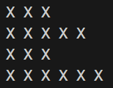
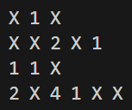
Here’s what we created today – that’s enough for now!
The kitchen manager would take our grid and add in the orders for the day, like this.

Slide 42
BACK TO THE C++ PROJECT

Slide 43
Program Description
3 files to submit: route.h, route.cpp, planRoute.cpp
No required functions, however….
  Look at the Redact Notes, Spellcheck, House Hunting, Rover Mission, Containerships, and Energy Management programs that we have written/will write in class
  Note where, when, and why we chose to create helper functions, vectors, and structs.
  Individual tasks are often great candidates for helper functions!
  Make helper functions for this program! Write their prototypes and definitions in the library files, then call them in the driver program.

Slide 44
Test Case Data Set
There are two test case data sets for you to use in testing your program
Test Case #1
Read data from these files:
locations_1.txt
names_1.txt
And check that your journey.txt file matches the journey_1.txt file
Test Case #2
Read data from these files:
locations_2.txt
names_2.txt
And check that your journey.txt file matches the journey_2.txt file

Slide 45
Project Submission
Submit three files (route.h, route.cpp, planRoute.cpp) to the Autograder.
You must work on your own for the project.
READ the project specifications for lots more details!
Check the FAQs in the specifications when you’re stuck or don’t know how to get started.
Remember!
Only the C++ skills, approaches, and exercises that we use in this course can be used to complete the C++ Project!

Slide 46
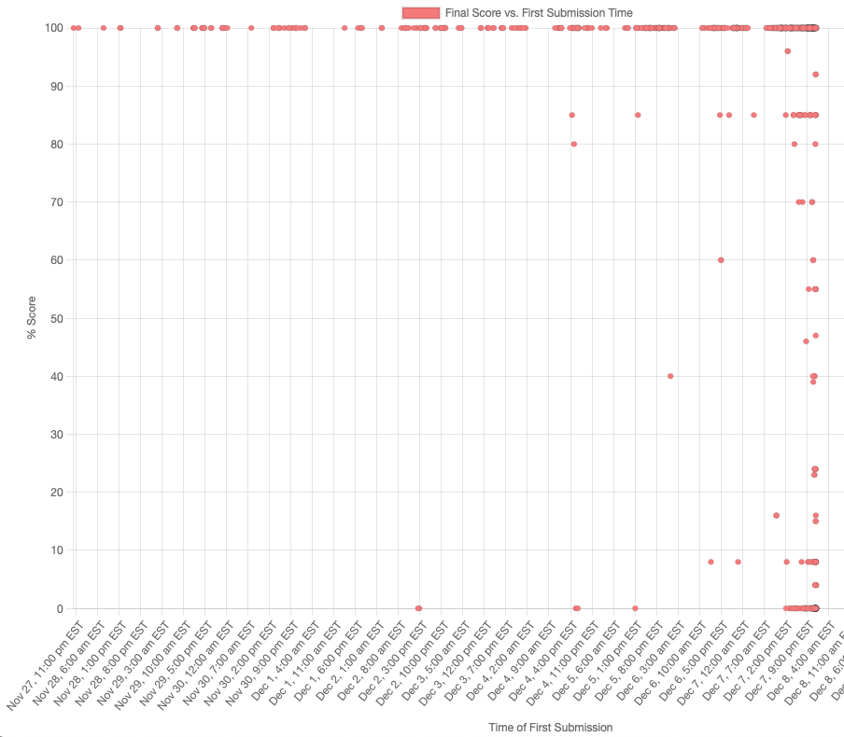
We’re not joking.
START EARLY!
Are you really willing to bet your C++ Project grade that you’re going to be one of these people?
These people started early and ended up getting 100% on the C++ Project last year.
These people started the project late and ended up getting… probably not the grade they wanted. ☹

Slide 47
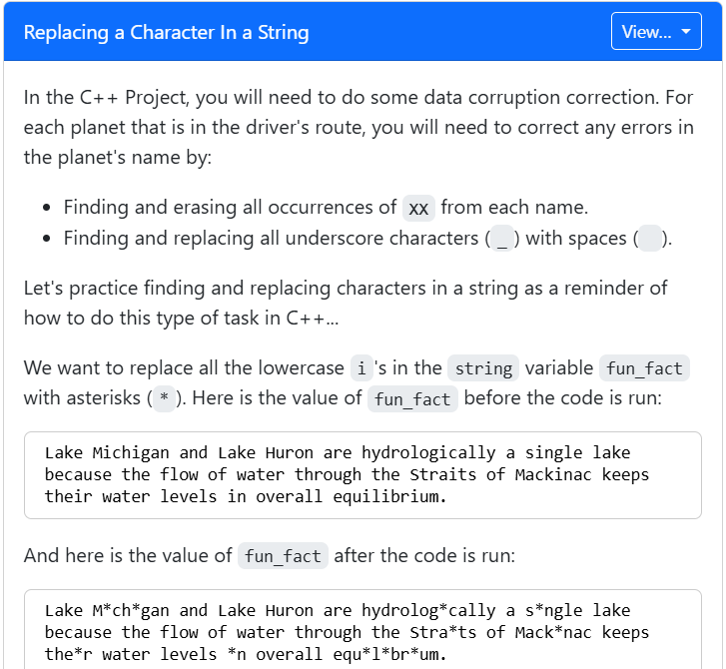
Reminder!
The lecture reflection will help you get started on the C++ Project!
reviewing some basics is always helpful in getting started with a project!
The lecture reflections aren’t really an attendance check. They are meant to reinforce your learning.
In particular, the reflections that correspond to Project Overview lectures will help you start planning your project program!

Slide 48
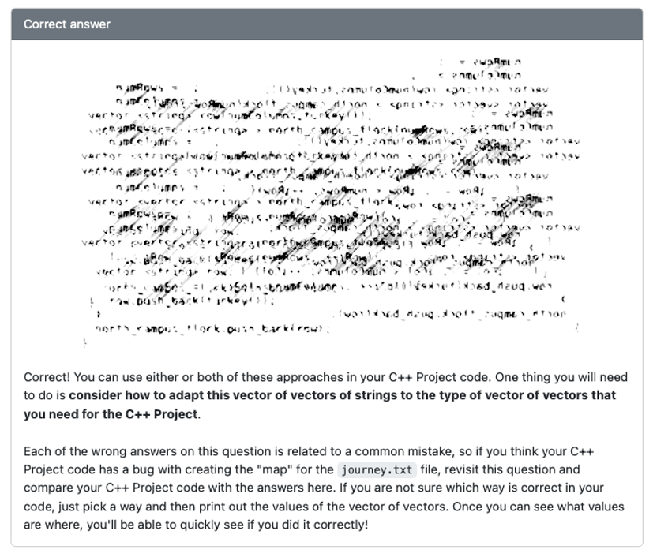
Check the “Correct Answer” Box for Additional Help!
For example, in this question on “creating a vector of vectors”, the “Correct Answer” box will give you your answers as well as some advice on using the example in the C++ Project.

Slide 49
That’s all for today!
Reminders:
C++ Project Spec Review due Saturday
Complete the reflection for this lecture (due Saturday)
Lab exercises due Saturday

